Slide 1
18.0 Move In, Move Out, Manage Customer Transfers and Owner Allocation Today's Discussion: Workshop A-1 Move In Mohanta Das, Jose Diaz 5/27/26

Slide 2





Overarching Design Principles
The goal of this project is to utilize standard Service Cloud V2 capabilities with minimal customizations. We will strive to modify our processes to Fit-to-Standard SAP technology as much as possible.
SAP First
We will adopt an “SAP first” strategy with all financial and operational data housed within SAP.
Fit to Standard
Rationalize Applications
We will change and adapt our existing business processes to fit to standard ‘out of the box’ functionality.
We will standardize and rationalize our applications to control costs and reduce the complexity of our IT estate.
Minimize customizations
‘Best of Breed’ by exception
Non-SAP applications will only be considered if they are considered ‘best of breed’ and are necessary to enable competitive advantage or meet complex regulatory requirements.
We will minimize customizations and keep the core clean to ease future upgrades, improving agility and scalability.

Slide 3
Workshop Agenda*
TOPIC
01
Purpose
(L3) Manage Customer Move In
BREAK – 10 Mins
Current and Future State Assumptions
FRICE-W
Drafted User Stories
3rd Party Integration
Data Migration
Key Decisions, Action Items, Change Impacts, Wrap-Up, and Next Steps
02
03
04
05
06
07
08

Slide 4
01 Scope, Purpose, Objective

Slide 5
Scope, Purpose, Objectives
Scope
Purpose
Objective
Scope of this document covers the to-be state of the Move In Process for SAP Service Cloud v2 and SAP S4HANAer
Describe and confirm the Move In Process
Offer a holistic view of all the key elements of the to-be process including organization/roles, configuration or customization if needed, data, reporting, security, and controls requirements.
Define the target-state ownership and L3 processes.
Document key assumptions/decisions and outline any FRICE-W's and reports.

Slide 6
Ownership
Workshop/PDD | Level 1 | Level 2 | Level 3 | Teams Impacted | Business Process Owner | Reviewer
18.0 A-1 Process Customer Move-In, Move-Out, Transfers, and Manage Owner Allocation | Manage Customer Service | Process Customer Move-In, Move-Out, Transfers, and Manage Owner Allocation | 18.1 Manage Customer Move in | Customer, WAM | Tarah Wilson, Dawn Pettengill | Core Team
 |  |  | 18.2 Manage Customer Move out | Customer, WAM | Tarah Wilson, Dawn Pettengill | Core Team
 |  |  | 18.3 Manage Customer Transfer | Customer, Finance | Tarah Wilson, Dawn Pettengill | Core Team
 |  |  | 18.4 Manage Landlord/Tenant | Customer | Tarah Wilson, Dawn Pettengill | Core Team
WORKSHOP FACILITATION
Facilitator: Mohanta Das, Jose Diaz
IBM Scribe: Taylor Ilov
Change Impacts: Julie Vandblarcum
CE PARTICIPANTS
Global Process Owner: Tarah Wilson
SMEs

Slide 7
02 (L3) Manage Customer Move In

Slide 8
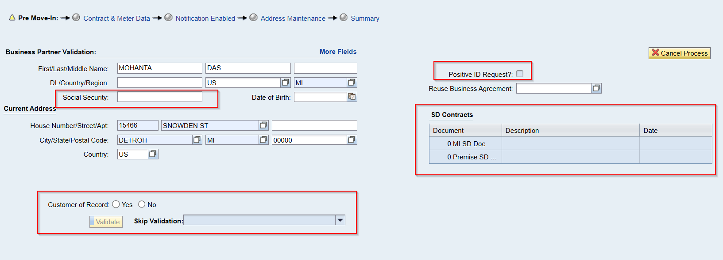
Process Overview- Move In

Slide 9
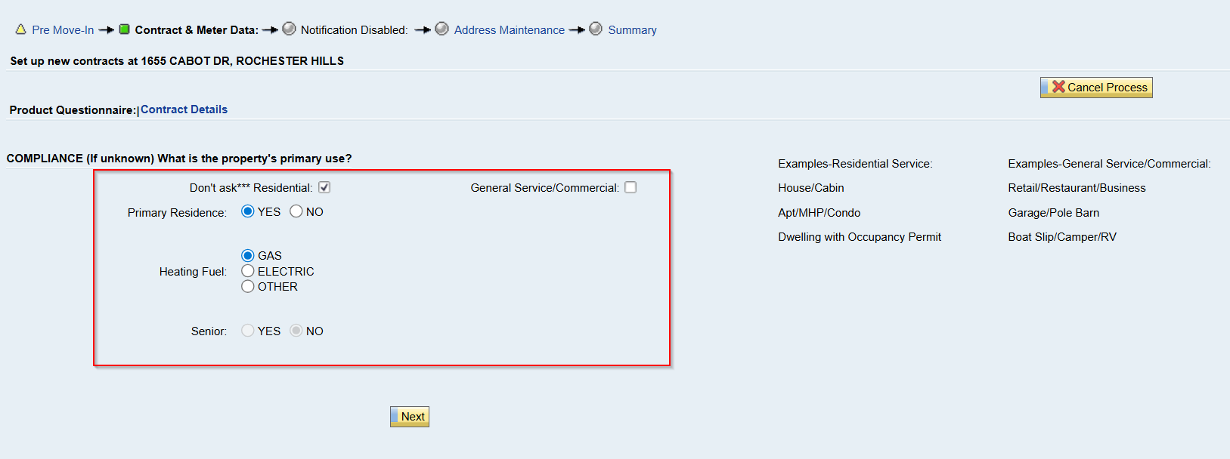
Move In

Slide 10
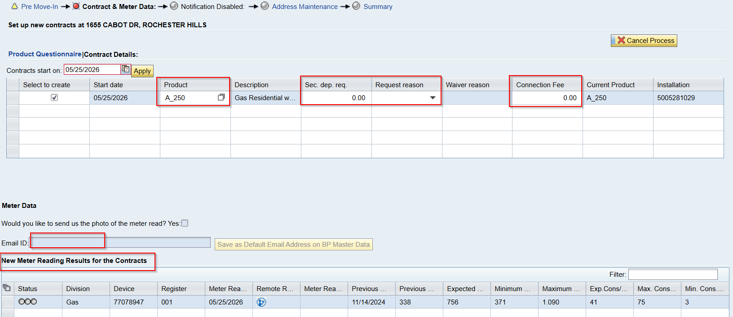
Move In

Slide 11
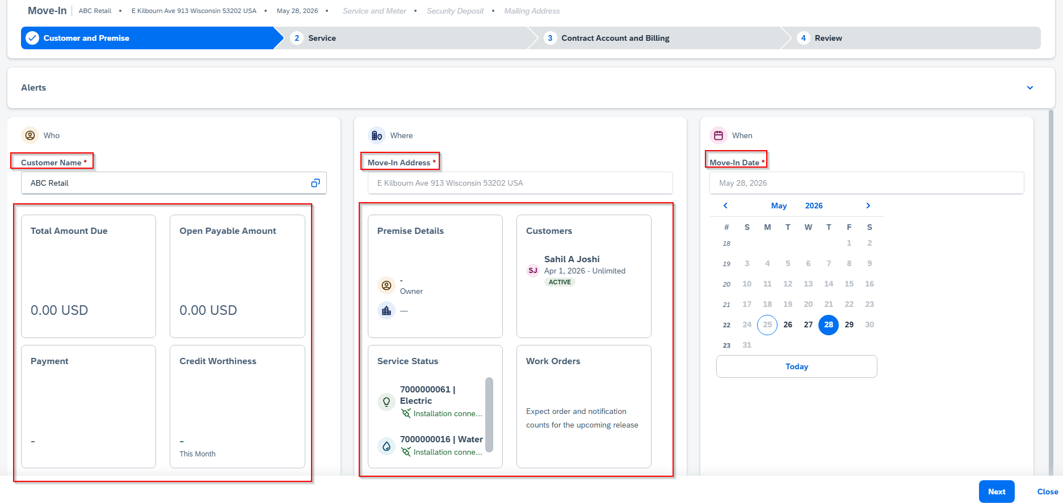
Move In- Service Cloud V2

Slide 12
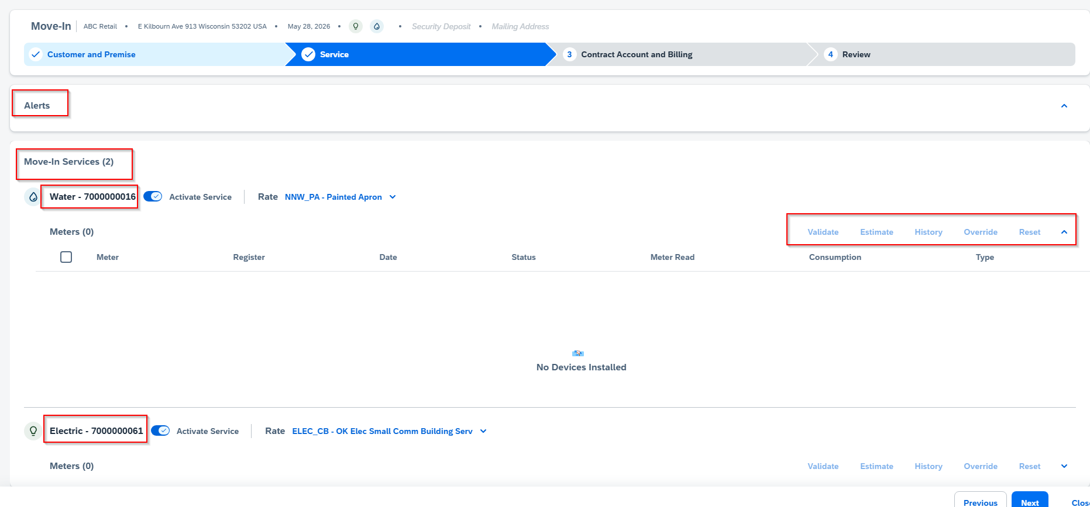
Move In- Service Cloud V2

Slide 13
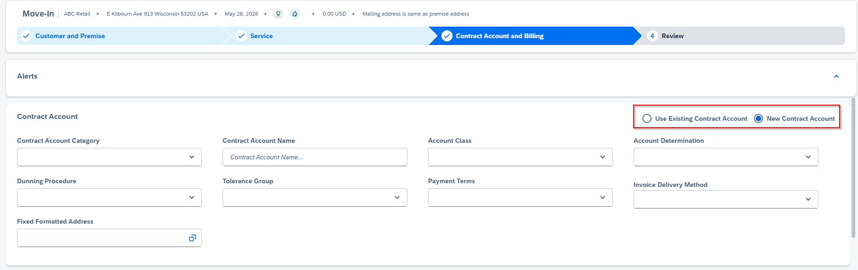
Move In- Service Cloud V2
Notes:
@Jose & Mohanta – can these fields default based on the rate from previous screen?

Slide 14
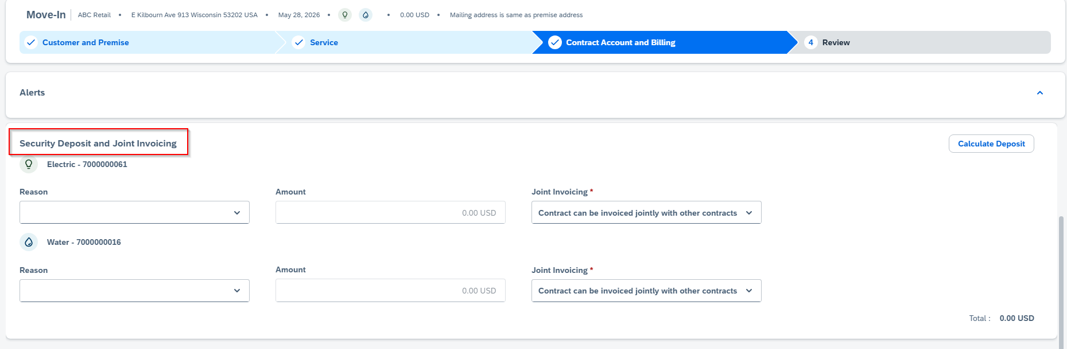
Move In- Service Cloud V2

Slide 15
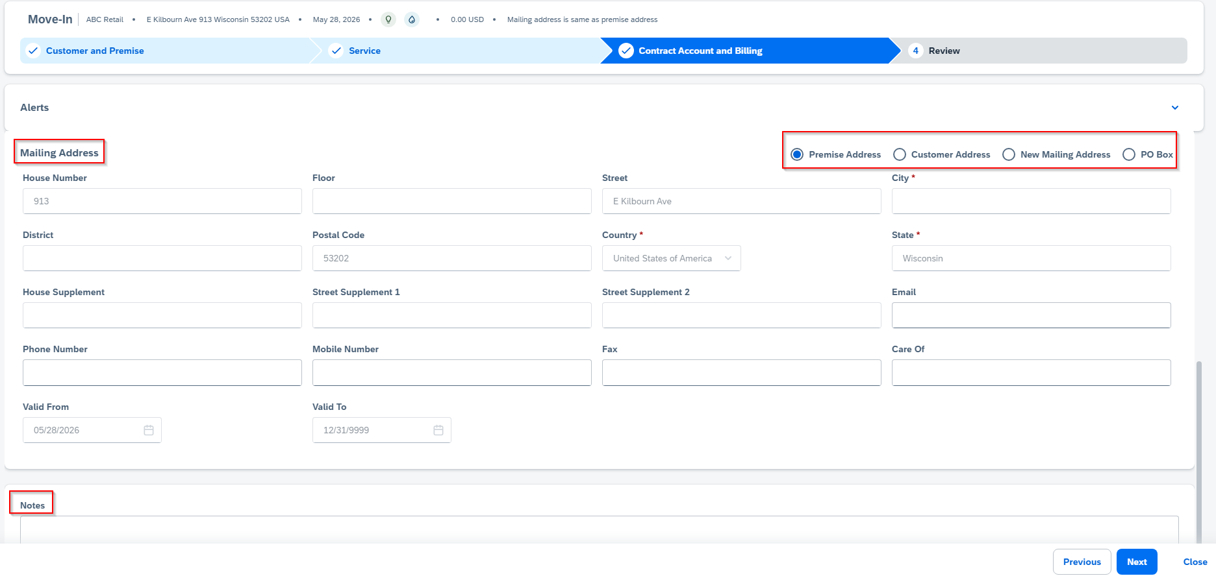
Move In- Service Cloud V2
Notes:
@Jose – Mohanta street is not a mandatory field?

Slide 16
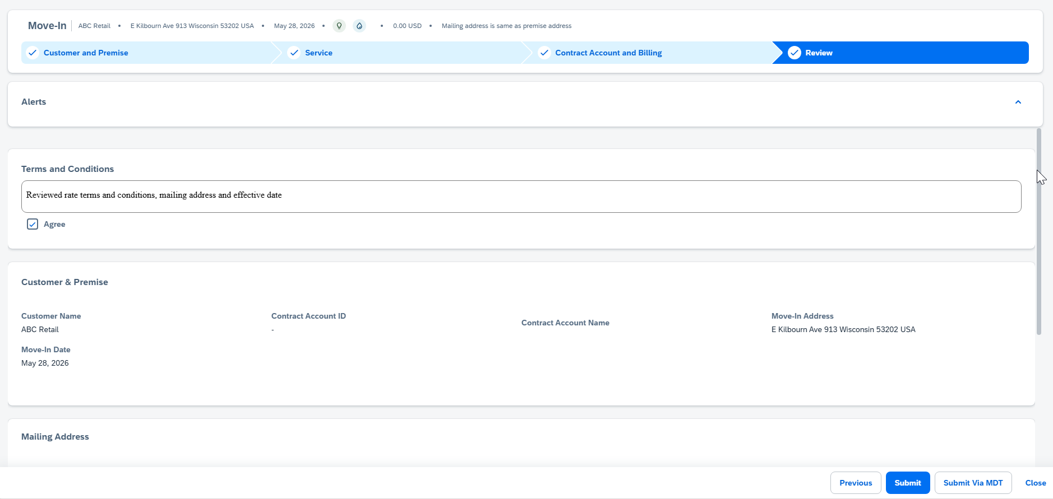
Move In- Service Cloud V2

Slide 17
CE Business Requirement and Proposed Solution on Service Cloud V2:
DL: Must start with alphabet A-Z and should be of length of 13 char. Insert DL on Move in wizard as per AS-IS process.
Solution: To be noted during workshop.
2. SSN: Must of length 9 char. Insert SSN on Move in wizard as per As-IS process.
Solution: To be noted during workshop.

Slide 18
CE Business Requirement and Proposed Solution on Service Cloud V2:
3. FACTA validation- Create Contact to verify FACTA. FACTA can be skipped with specific reasons.
Solution: To be noted during workshop.
4. Positive Id request: Rules to enable the field.
Solution: To be noted during workshop.

Slide 19
CE Business Requirement and Proposed Solution on Service Cloud V2:
5. Product Questionnaire: AS-IS process.
Solution: To be noted during workshop.
6. Collect Email id on Move in process : This is required, if customer wants to send Meter read via email.
Solution: No Need in SC V2
7. Appointment: Show 5 days appointment from FSM.
8. Move In Alert:

Slide 20
Move in Workflow
Objects created on back of Move in | Criteria
Security Deposit | Dunning Level, Write off balance, Unpaid final amount due
Turn on Service order | If Device is Off.
Connection Fees | No.
Contact Log SDR Contact Log POS ID Contact Log | SDR Contact Log: Security deposit initiation. POS ID Contact Log: Positive FACTA Validation- Fails 2. Non-FACTA Positive Identification (POS ID COS) triggers. Note: SDR Contact Log gets priority over POS ID Contact Log.

Slide 21
BREAK! - 10 mins

Slide 22
03 Current and Future State Assumptions - Move In

Slide 23
Assumption:
Workflow: No Change
MDT: No Change

Slide 24
04 FRICE-W – Move In

Slide 25
FRICE-W Identified
1. Move in field enhancements
2. Move out field enhancements
2. Enhancements in ECC may be required if looking for specific details in container from CRM7 now coming from v2 system.
3. Workflow changes in ECC may be required if looking for specific details in container from CRM7 now coming from v2 system.
4. Service Cloud enhancements to send custom container payloads for fields for certain scenarios.
5. DQM address cleanse
6. Create Contract Account Based on Current MDT Maintenance
7. Auto Populate Contract Account values
8. Create Service Orders
9. Premise enhancements
10. Enrollments
11. Security Deposits
12. Equifax check
13. Move in validations from ECC (i.e. Override past due balances)
14. Move in change event(s) placeholder
15. Move in cancel event(s) placeholder
16. Move out change event(s) placeholder
17. Move out cancel event(s) placeholder
18. Transfer items to new CA, new premise
19. change Rate, Operand
21. Smart Meter (Gas and Electric) Opt In/ Opt Out
22. Move Out Summary Script

Slide 26
Initial FRICE-W List for Move In
Area | WRICEF Name | Action | Considerations
Reporting | Auto Populate Contract Account values
Interface​ | Appointment​
Interface | FACTA Validation ​
Interface | Address Validation
Enhancement | Move In Fields
 | DQM address cleanse
 | MDT Placeholder
 | Create Service Orders
Enhancement | Premise Enhancements
 | Equifax Check
 | Move In Validations from ECC (Past Due Balances)
 | Move in change event(s) placeholder
 | Move in cancel event(s) placeholder
Notes:
2. Enhancements in ECC may be required if looking for specific details in container from CRM7 now coming from v2 system. 3. Workflow changes in ECC may be required if looking for specific details in container from CRM7 now coming from v2 system. 4. Service Cloud enhancements to send custom container payloads for fields for certain scenarios.

Slide 27
05 Drafted User Stories

Slide 28
Drafted User Stories – Move In
L1 | L2 | L3 | L4 | User Story | Acceptance Criteria
Manage Customer Service | Process Customer Move-In, Move-Out, Transfers, And Manage Owner Allocation | Process Customer Move-In | Create Move-In | As a Customer Service Representative in SAP, I want to process customer move-in so that I can accurately create and record new move-in requests within the Manage Customer Service application and its move-in processing area. Would like to process With or without FACTA validation. | 1. Able to enter move-in details required to create a new record. 3.Able to validate that mandatory fields are completed before saving. 4.Able to save the new move-in record successfully. 5.Able to edit move-in information prior to final submission. 6.Able to submit the move-in creation and receive a confirmation. 7.Able to view the created move-in record after submission. 8.Able to view error messages when move-in creation fails. 9.Able to build Security roles and perform testing. 10.Able to identify Risk and Controls 11. Able to fulfill AS-IS process requirement.

Slide 29
Drafted User Story Overview and Acceptance Criteria – Move In
User Story Name | User Story Description | Acceptance Criteria
Create Move-In from Interaction | Agent creates move-in from interaction so service starts on requested date with correct master data linkage. | • Premise search by address/installation/contract account • Move-in date validated against last move-out • BP and contract account linked without duplicates • Product/rate assigned by premise and segment • Blocks save if mandatory data missing
SSN Identity Verification and FACTA validation | Compliance specialist verifies customer identity during move-in to meet regulatory and internal FACTA requirements. | • Captures SSN •
Create Move in without FACTA

Slide 30
06 3rd Party Integration

Slide 31
Integration Points with Other Programs/Applications- Move In
Application(s) | Integration Requirement / Impact
SAP S/4HANA Utilities (IS-U) | Create move-in document, link contract/account to premise, set move-in date, trigger billing-relevant status
DQM | Address Validation
Equifax | Creditworthiness validation
FSM | Appointments

Slide 32
07 Data Migration – Move In

Slide 33
Data Scope – Move In
Category | Data Elements | Key Rules & Constraints
Move in Document | EEINV- All Fields​
Contracts | EVER- All Fields

Slide 34
08 Key Decisions, Action Items, Change Impacts, Wrap-Up & Next Steps

Slide 35
Program Charging (CE Internal Only)
The Change & Why:
We need to track O&M costs more precisely. OCM and Data Conversion must be charged separately from End User Training and from Design/Build/Deployment work. This change is retroactive from February for Accounting, Rate case discovery, and audit.
Ask:
Pls follow the instructions below that apply to you based on your staffing category on the LaunchPad program. It is critical to track costs in the correct cost buckets.
Business Partner (BP) Core Team (Use SAP*):
Continue 100% allocation as before. (BP&A handles this automatically behind the scenes and no time entry is needed except for the two scenarios below)
Submit time only for OCM and Data Conversion activities; Use SAP to bill IO 6520973.
Submit time only for End User Training; Use SAP to bill IO 6519532.
IT Core Team (Use Clarity):
S4- Customer – Design/Development/Testing/Deploy Clarity Task
Clarity Timesheets will now be used for time charging, and the allocation mechanism is discontinued. Submit timesheets from February 2nd for a one-time catchup.
Separate tasks for OCM, End User Training, and Data Conversion are available; Find them using keywords OCM, End User Training, and Data Conversion and charge them as applicable.
Extended BP Team (use SAP*):
Bill SAP IO 6520973 for OCM and Data Conversion.
Bill SAP IO 6519532 for End User Training.
Use new IO 6521411 for all other tasks.
Extended IT Team (Use Clarity):
S4- Customer – Design/Development/Testing/Deploy Clarity Task
Bill specific tasks for OCM, End User Training, and Data Conversion; ID the tasks using the keywords OCM, End User Training, and Data Conversion.
Bill other tasks as appropriate.
*SAP Timesheet Submission Instructions (for BPs)
Follow ESS steps (screen shot below): 1. Open ESS timesheet. 2. Enter IO number in work order field. 3. Select WORK code under ATT-ABS. 4. Add OCM, End User Training, or Data Conversion in comments. 5. Enter hours worked.

